Slide 1
Task Based ConcurrencY
Scaling to Many Cores

Slide 2
Partitioning input data
The best way to take advantage of Amdahl’s Law is to organize an algorithm to partition it’s input data.
The size of the input data will grow over time
The number of cores will grow over time
Therefore our performance will grow over time
The free lunch is back!

Slide 3
Task based concurrency
Task based concurrency provides a mental framework to partition input data for many problems.
Write the algorithm so that it can act on data of any size
Partition the input data into smaller chunks
Apply the algorithm to each partition separately (map)
Aggregate the results on each partition (reduce)
The map-reduce approach is one way to implement task-based concurrency.
* Simplist and most useful

Slide 4
How to implement Map-REduce
The map-reduce approach is implemented by a number of libraries.
Intel Threading Building Blocks
Microsoft Parallel Patterns Library
Let’s write our own, simple implementation.

Slide 5



Problem: Matrix Multiplication
Recall how matrix multiplication works:
$$\left[\begin{matrix}2 & 3 \\ −1 & 2\end{matrix}\right]\left[\begin{matrix}1 & 0 \\ 6 & −2\end{matrix}\right]=\left[\begin{matrix}20 & −6 \\ −12 & −4\end{matrix}\right]$$
$$2∙1+3∙6=20$$
$$2∙0+3∙−2=−6$$

Slide 6
A simple map-reduce implementation
Let’s read a simple map-reduce parallel task implementation
Process for sight-reading code:
First pass: Understand structure
Methods names
Arguments
Return values
Second pass: ignore details, look for landmarks
Third pass: focus on details
What landmarks should we find?
Partitioning
Map – puts it off into different threads
Reduce – brings it back together
Notes:
See matrix multiplication example solution

Slide 7
Find it in use
Let’s see if there is a client for this code.
Look for unit tests first
Likely the simplest of clients
Usually represent the canonical usage
How could we use this code for matrix multiplication?

Slide 8
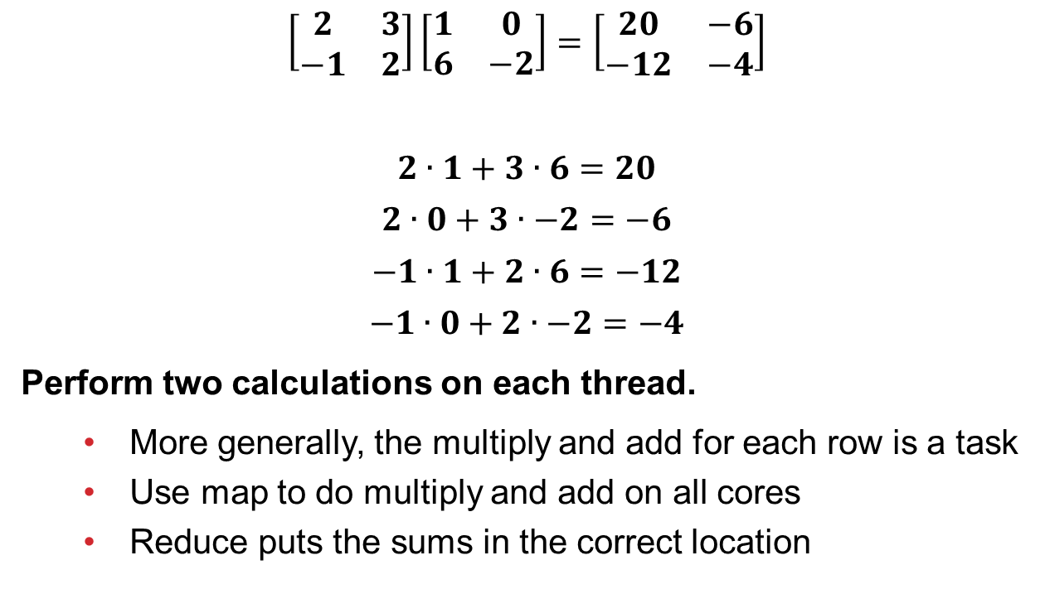
Use with Matrix Multiplication
$$\left[\begin{matrix}2 & 3 \\ −1 & 2\end{matrix}\right]\left[\begin{matrix}1 & 0 \\ 6 & −2\end{matrix}\right]=\left[\begin{matrix}20 & −6 \\ −12 & −4\end{matrix}\right]$$
$$2∙1+3∙6=20$$
$$2∙0+3∙−2=−6$$
$$−1∙1+2∙6=−12$$
$$−1∙0+2∙−2=−4$$
Perform two calculations on each thread.
More generally, the multiply and add for each row is a task
Use map to do multiply and add on all cores
Reduce puts the sums in the correct location

Slide 9
Example
Let’s see an example.

Slide 10
analysis of this approach
This approach has costs and benefits.
Benefits
Scales to many cores (f_{s} is small)
Understandable – follows hand multiplication process
Costs
Poor cache performance if rows are large
Traverses left and right matrices in different ways

